Slide 1
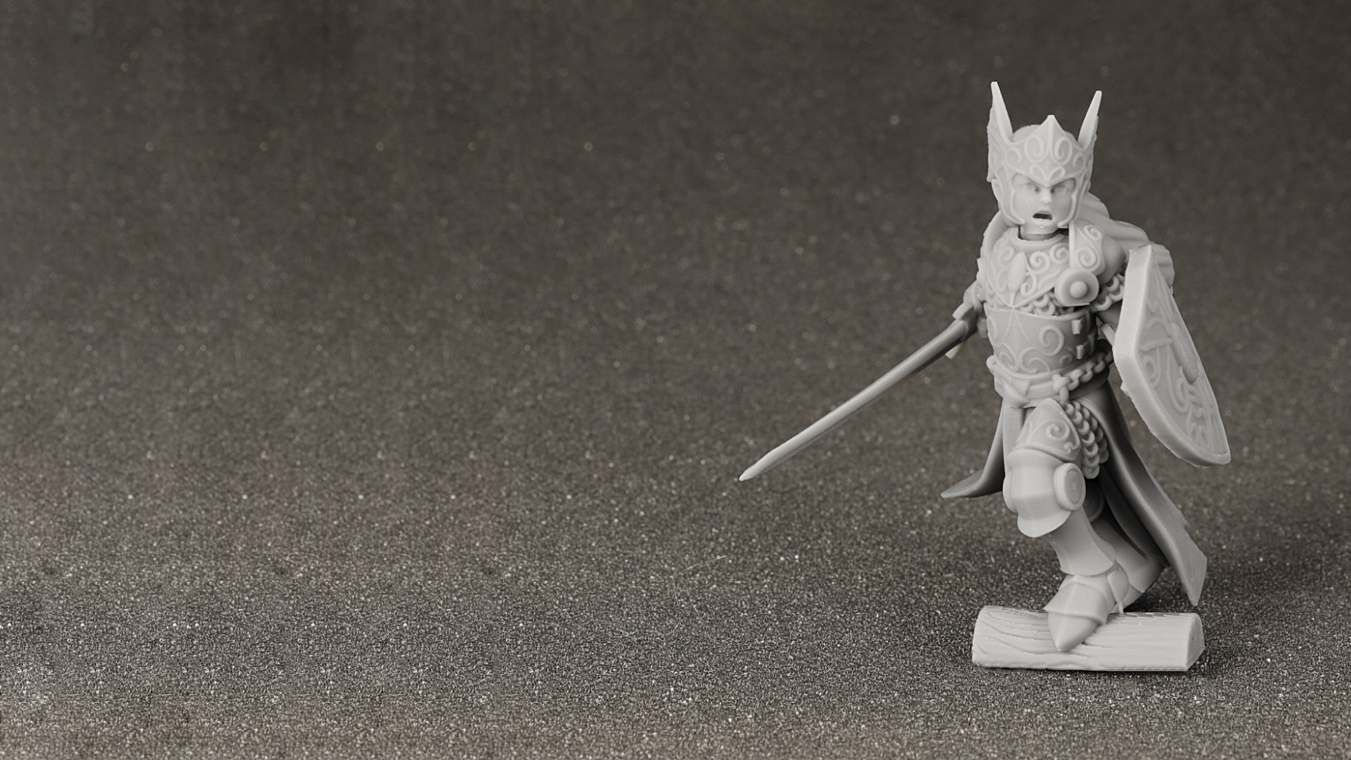
Ultracur3D® ST 7500 G
^{Product Launch Package}
BASF 3D Printing Solutions (B3DPS)
Status November 2022

Slide 2
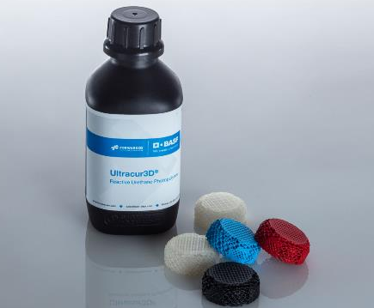
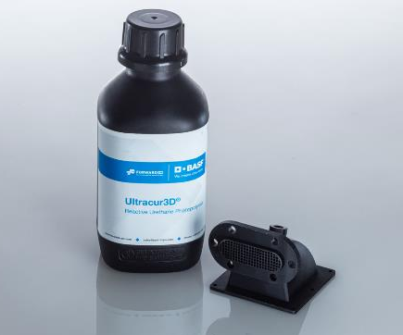
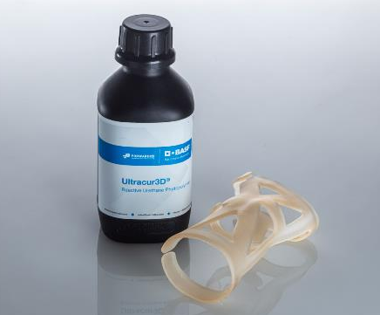
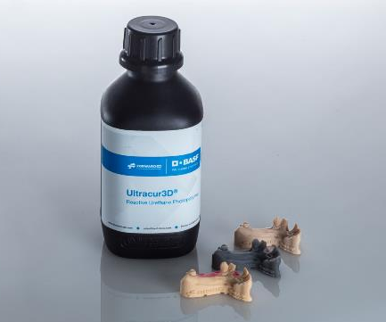
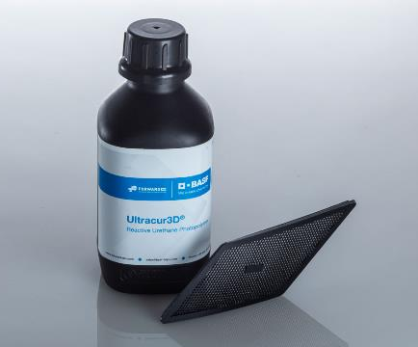
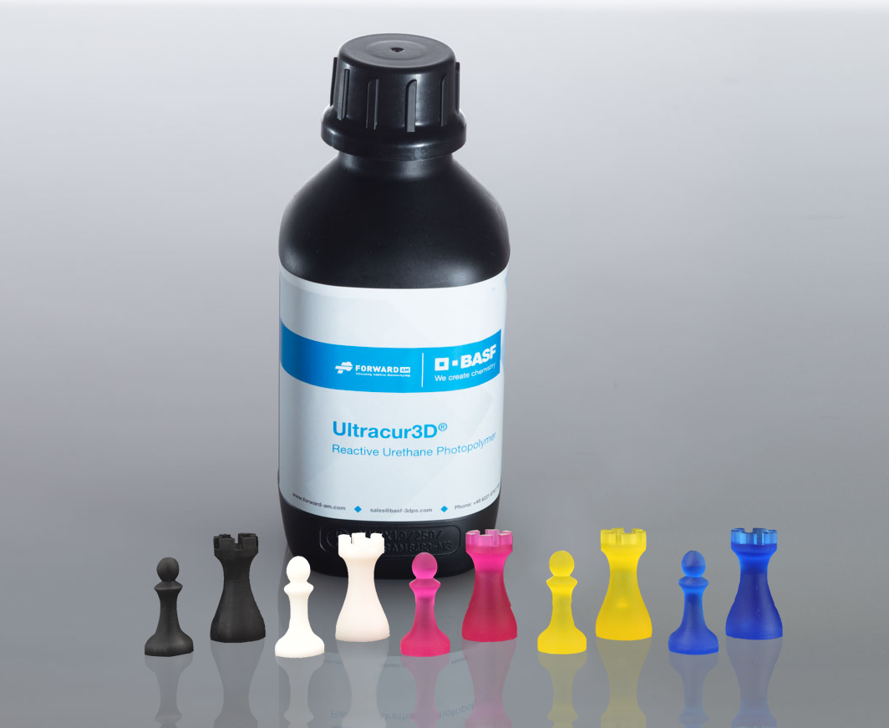
Ultracur3D® Photopolymer Solutions – Our product lines
Flexible
Tough
Rigid
Dental
Daylight
Supplementary

Slide 3
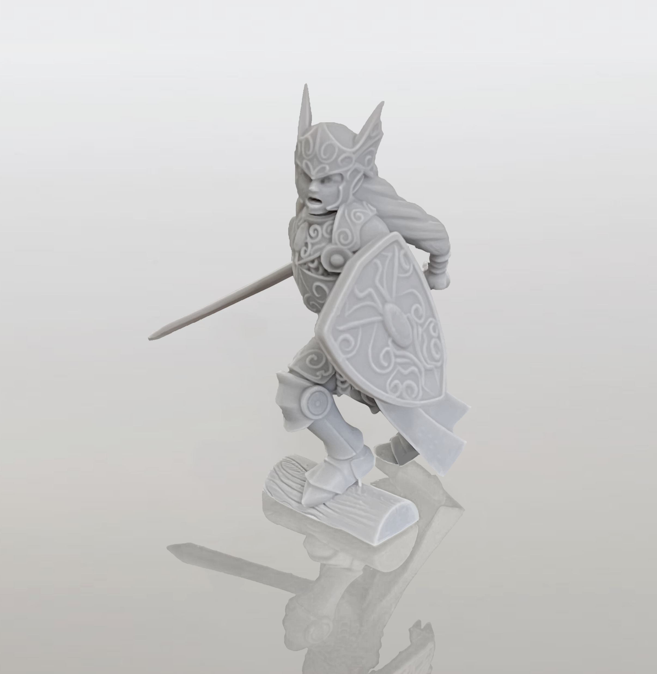
Ultracur3D® ST 7500 G
Material Introduction
Ultracur3D® ST 7500 G by Forward AM is the latest addition to our tough product line. This material is extremely fast and easy to print, with printed parts showing excellent surface quality and intricate details. This makes the material perfect for applications like figurines, hobby models and functional prototyping.
In addition, with a combination of high toughness and low water absorption, this material is perfect for any applications where high durability is required, for example for outdoor use.
The material is available in grey.

Slide 4
Ultracur3D® ST 7500 G
Value Proposition
Ultracur3D® ST 7500 G:
Multi-purpose resin with high durability and fast easy printing
Very fast and easy to print
Excellent surface quality and intricate details
High durability and toughness
Color: Grey
General availability: 11/2022
Young’s Modulus | 2,300 MPa
Tensile Strength | 54 MPa
Elongation at break | 13 %
Impact strength (Izod notched) | 25 J/m
HDT (0.45 MPa) | 64 °C
HDT (1.82 MPa) | 54 °C
Water absorption (24h) | 0.9 %
Viscosity (30°C) | 130 mPas
Compatible technologies* | DLP, LCD
* This is only a general indication for compatibility, as there is a very wide range of different printers available in the
market. If you have any question about machine compatibility, contact us at sales@basf-3dps.com

Slide 5
Ultracur3D® ST 7500 G
Benchmarking
 | ST 1400 | ST 80 B | ST 45 B | ST 7500 G | Competitor product
Young’s Modulus | 1,900 MPa | 1,650 MPa | 2,000 MPa | 2,300 MPa | 2800 MPa
Tensile Strength | 45 MPa | 35 MPa | 53 MPa | 54 MPa | 65 MPa
Elongation at break | 43 % | 25 % | 21 % | 13 % | 6.2 %
Impact strength (Izod notched) | 43 J/m | 22 J/m | 30 J/m | 25 J/m | 25 J/m
HDT (0.45 MPa) | 57 °C | 52 °C | 63 °C | 64 °C | 73 °C
HDT (1.82 MPa) | 49 °C | 44 °C | 52 °C | 54 °C | 58 °C
Water absorption (24h) | 0.33 % | 0.5 % | >5 % | 0.9 %
Viscosity (30°C) | 280 mPas | 440 mPas | 230 mPas | 130 mPas
Ultracur3D® ST 7500 G is a multi-purpose resin with high durability and fast easy printing.
Compared to other materials in our tough product line: It has slightly lower impact resistance than Ultracur3D® ST 45 B, but much lower water absorption as well. Compared to Ultracur3D® ST 80 B, it has overall better mechanical performance and is much faster printing.
In comparison to an existing general purpose grey product on the market, Ultracur3D® ST 7500 G shows very similar performance, with a higher elongation at break but slightly lower Young’s modulus and HDT.
Additionally, Ultracur3D® ST 7500 G is TPO-free.

Slide 6





Ultracur3D® ST 7500 G
Certifications & Post-Processing
Bio compatibility
  Tested on Ultracur3D® ST 7500 G. Testing results available as per the ISO Norm ISO 10993-5.
Sterilization
  Not tested.
Chemical resistance
  Testing ongoing. Results available soon.
UV resistance
  Testing ongoing. Results available soon.

Slide 7
Ultracur3D® ST 7500 G
Example of Suitable 3D-Printers and Settings
Evaluation on additional systems ongoing.
Further details can be found in the User Guideline.
PRINTER | MIICRAFT ULTRA 125 | PHROZEN SONIC MINI 4K | RAPIDSHAPE I30+
Wavelength | 385 nm | 405 nm | 385 nm
Power | 4 mW/cm² | ca. 1.4 mW/cm² | 2 mW/cm²
Curing time | 3 s | 9 s | 3.5 s
Voxel depth | 100 μm | 100 μm | 100 μm

Slide 8
Ultracur3D® ST 7500 G
Available Documents
TDS
MSDS*
User Guideline
Certifications
Pictures
Not yet available.
TDS_Ultracur3D_ST 7500 G
UG_Ultracur3D_ST 7500 G
Pictures_
Ultracur3D_
ST 7500 G
NOTE: All MSDS are only initial and will not be updated in this presentation.
However, the links to the rest of the documents are always up-to-date. We recommend to use them instead of downloading the documents.
* MSDS available for the following countries:
US, CA, MX, EU, DE, AT, CH, BE, NL, LU, FR, ES, GB, IT, PL, CZ, DK, CN, TW, JP, KR, AU, NZ, MY, SG, BR

Slide 9
Ultracur3D® ST 7500 G
Battle card
Material overview
Key features
FAQ
Ultracur3D® ST 7500 G is a multi-purpose resin with high durability and fast easy printing. The material is characterized by:
Very fast and easy to print
Excellent surface quality and intricate details
High durability and toughness
Tough | Durable | Grey
Low water uptake
TPO-free
Easy to clean
Only short postcure time required
Will you also launch ST 7500 in clear or other colors like black or white?
At the moment, this is not planned, but if you have a business case, we can work on this.
What is the added value of the product being TPO-free?
TPO is a typical photoinitiator used in many commercial photopolymer resins. However, due to recent EHS classification changes in some regions, it could have specific safety concerns.
What are the main differences between ST 45 and ST 80 compared to the new material?
Please find details at slide 5.
Target industries
Example of suitable 3D printer
The excellent surface quality and intricate details of parts printed with this material as well as low water uptake makes it perfectly suitable for applications like figurines, hobby models, functional prototyping or outdoor use.
  MiiCraft - Ultra 125
  Phrozen - Sonic Mini 4K
  RapidShape – I30+

Slide 10
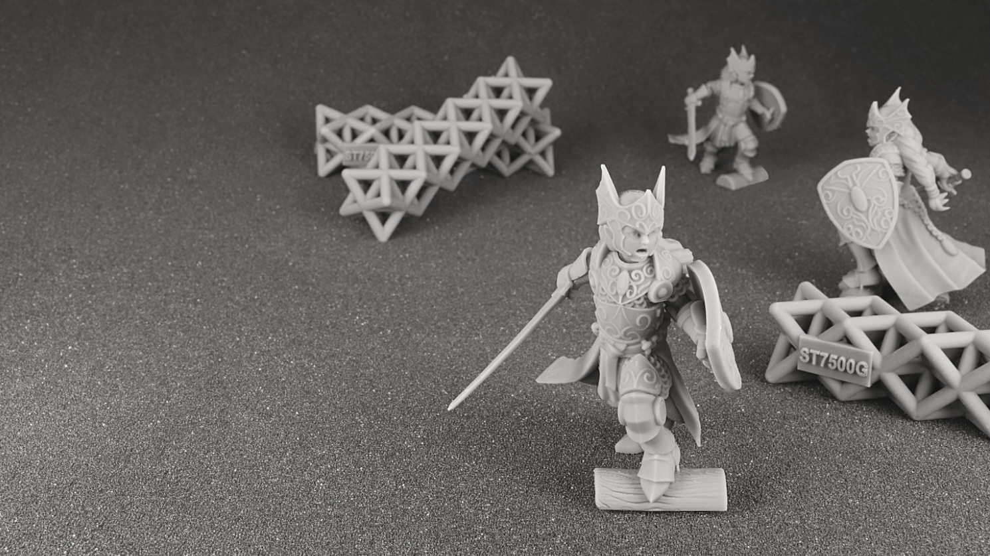
Our Mission
We enable our customers
to shape the
Additive Manufacturing industrial revolution.

Slide 11





Ultracur3D® ST 7500
Contact Details
Any questions left?
Let’s talk!
www.forward-am.com
sales@basf-3dps.com
+49 6221 67417-900
linkedin.com/company/basf-forwardam
At Forward AM we strive to provide you with the best service possible.
If you have questions about our materials, technologies or services, or would like to request an expert consultation, we will be delighted to hear from you!

