Slide 1
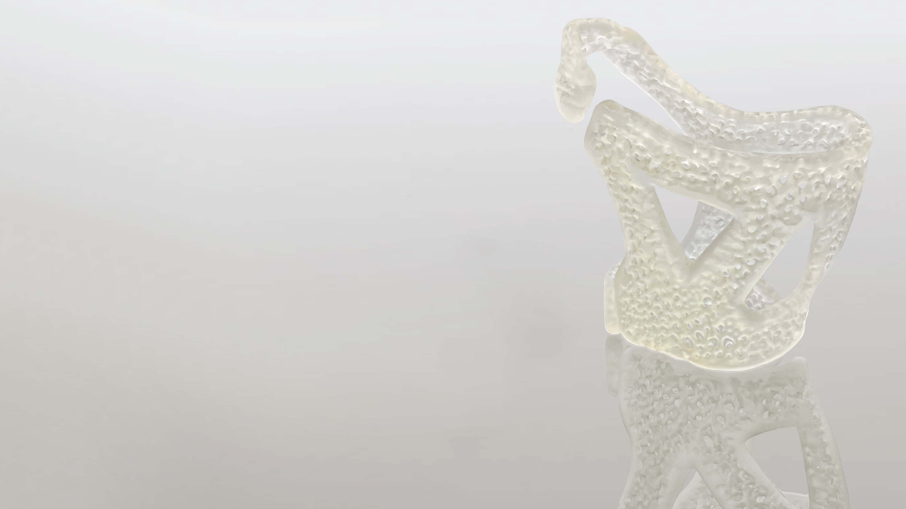
Ultracur3D® ST 1400
^{Product Launch Package}
BASF 3D Printing Solutions (B3DPS)
Status April 2022

Slide 2
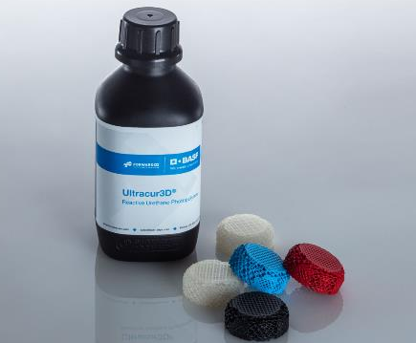
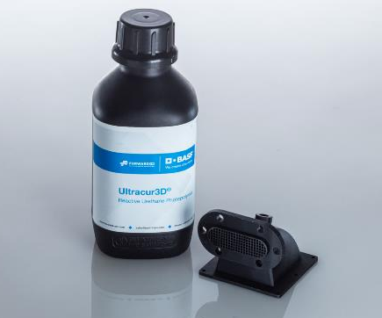
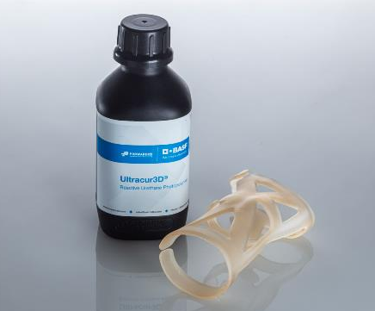
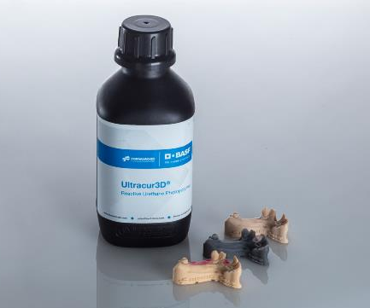
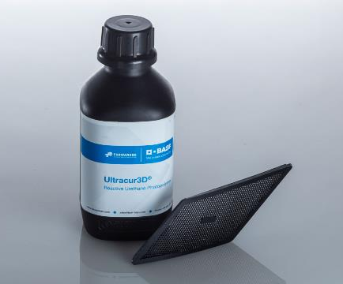
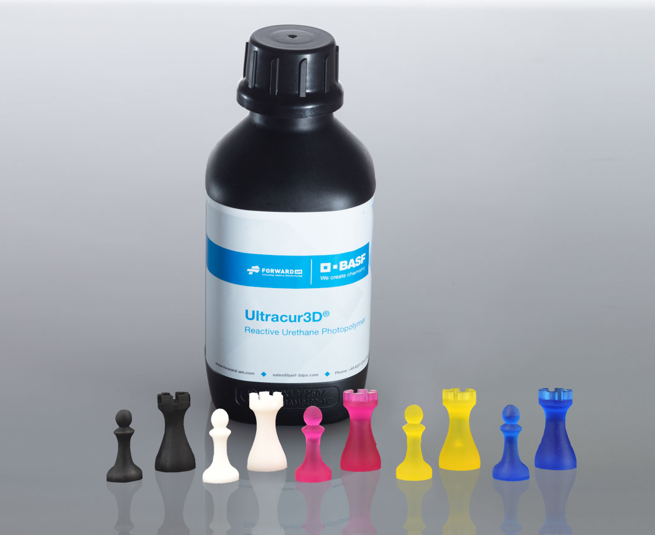
Ultracur3D® Photopolymer Solutions – Our product lines
Flexible
Tough
Rigid
Dental
Daylight
Supplementary

Slide 3
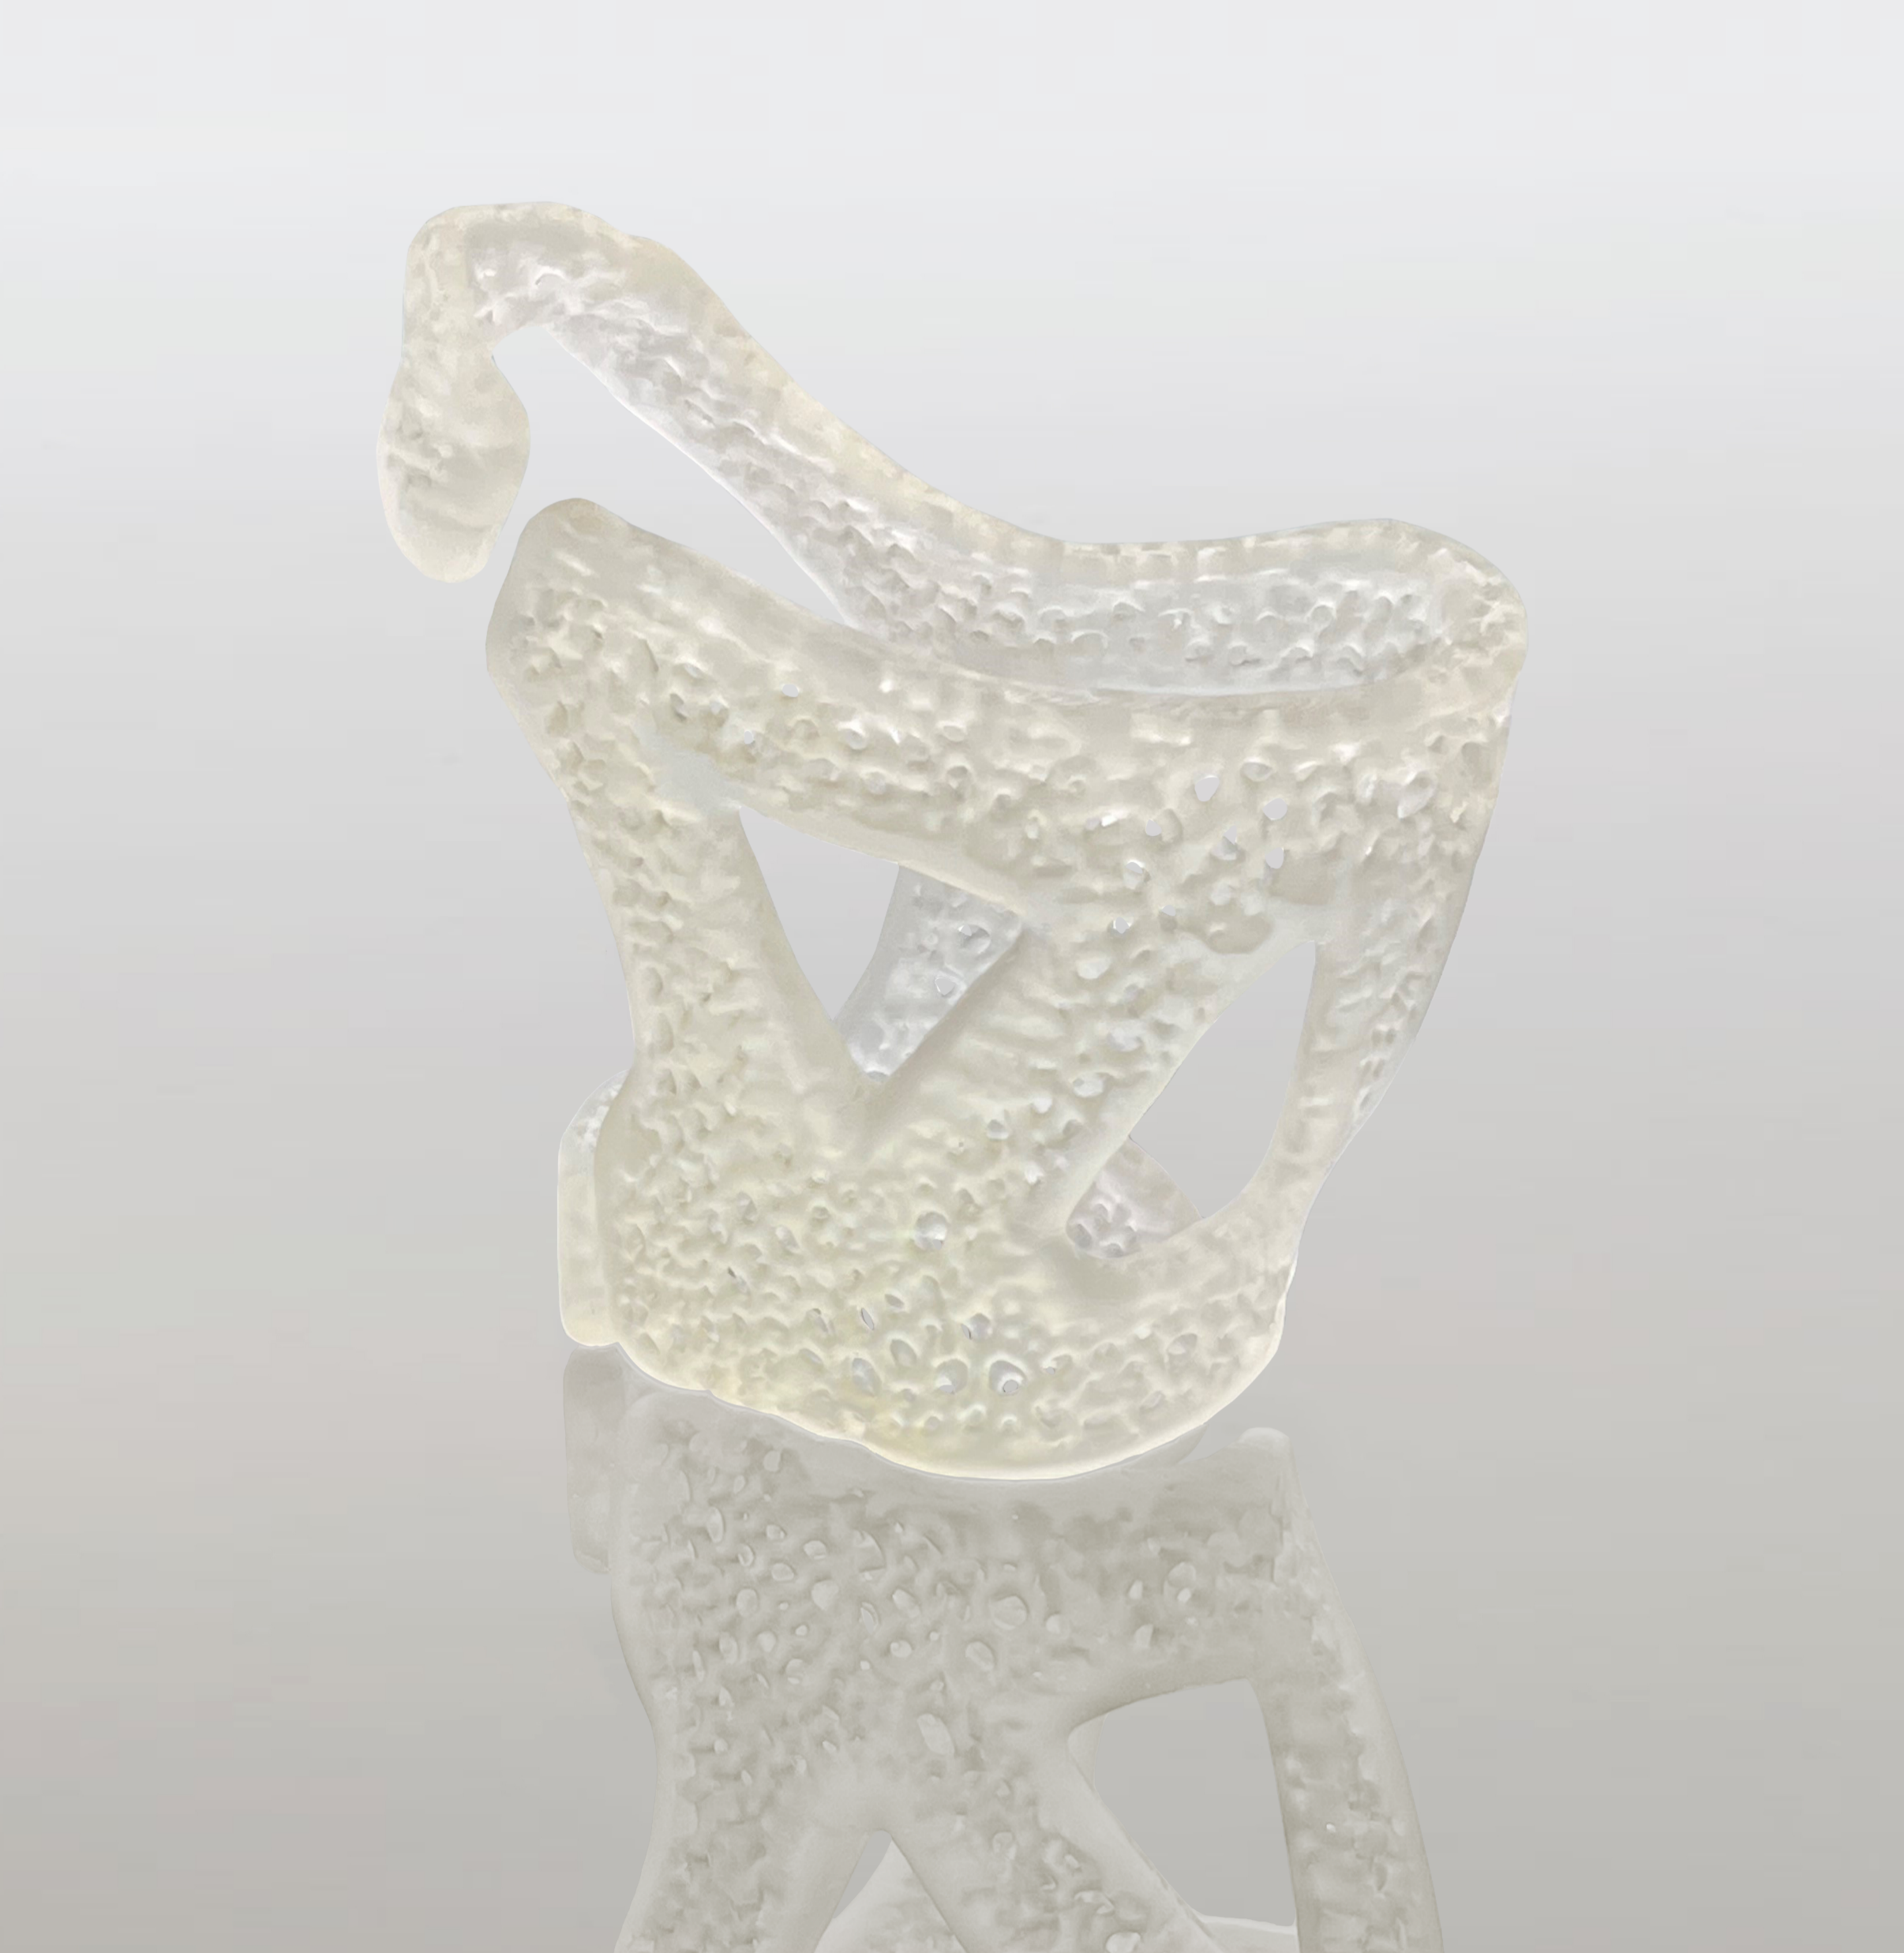
Ultracur3D® ST 1400
Material Introduction
Ultracur3D® ST 1400 by Forward AM is the latest addition to our Tough product line. It is a more ductile material with outstanding toughness and elongation at break, making it the perfect material to bridge the gap between our rigid and flexible product lines. Its high impact strength makes it ideal for applications where high durability and toughness are required. Its unique properties makes it comparable to an unfilled polypropylene.
Thanks to its high durability combined with its proven biocompatibility target markets could be consumer goods, medical and industrial with applications like wearables, prosthetics, medical accessories, diagnostic equipment, industrial housings and jigs & fixtures.

Slide 4
Ultracur3D® ST 1400
Value Proposition
Ultracur3D® ST 1400:
Multi-purpose resin with superior toughness and durability
Outstanding toughness and impact resistance
Medium stiffness, bridging the gap between flexible and rigid materials
Low viscosity and fast printing
Color: Clear
General availability: 05/2022
Young’s modulus | 1900 MPa
Tensile strength | 45 MPa
Elongation at break | 43 %
Impact strength (Izod notched) | 43 J/m
Water absorption (24h) | 0.33 %
HDT at 0.45 MPa | 57 °C
Viscosity, 25°C | 390 mPas
Compatible technologies* | LCD & DLP
* This is only a general indication for compatibility, as there is a very wide range of different printers available in the
market. If you have any question about machine compatibility, contact us at sales@basf-3dps.com

Slide 5
Ultracur3D® ST 1400
Benchmarking
Ultracur3D® ST 1400 is a more ductile material with outstanding toughness and elongation at break.
With a higher Young’s modulus and tensile strength as well as lower viscosity at 25 °C than Ultracur3D® EL 4000 and a better performance in elongation at break and higher impact resistance than Ultracur3D® ST 45, it’s bridging the gap between our rigid and flexible product lines.
Compared to an existing product on the market Ultracur3D® ST 1400 shows a higher Young’s modulus, tensile strength and HDT as well as lower viscosity at 25 °C. However, its elongation at break is lower.
Additionally, Ultracur3D® ST 1400 shows a very low water absorption.
 | EL 4000 | ST 1400 | ST 80 | ST 45 | Competitor product
Young’s modulus | 42 MPa | 1900 MPa | 1500 | 2300 MPa | 1500 MPa
Tensile strength | 11 MPa | 45 MPa | 35 MPa | 60 MPa | 43 MPa
Elongation at break | 172 % | 43 % | 20 % | 25 % | 120 %
Impact strength (Izod notched) | No break | 43 J/m | 24 J/m | 30 J/m | 50 J/m
Water absorption (24h) | 2.3 % | 0.3 % | 0.5 % | >5 % | 1.0 %
HDT at 0.45 MPa | - | 57 °C | 46 °C | 73 °C | 53 °C
Viscosity, 25°C | 470 mPas | 390 mPas | 400 mPas | 320 mPas | 2300 mPas

Slide 6







Ultracur3D® ST 1400
Certifications & Post-Processing
Bio compatibility
  Tested on Ultracur3D® ST 1400. Testing results available as per the ISO Norm ISO 10993-5 and ISO 10993-10.
Sterilization
  Tested on Ultracur3D® ST 1400. Results available for steam sterilization.
Chemical resistance
  Testing planned.
UV resistance
  Tested on Ultracur3D® ST 1400. Testing results available as per the ISO Norm ISO 4892-2:2013 Method A.
Coating
  Not tested.

Slide 7
Ultracur3D® ST 1400
Example of Suitable 3D-Printers and Settings
PRINTER | STRATASYS ORIGIN ONE | MIICRAFT ULTRA 125 | PHOTOCENTRIC LC OPUS | ATUM3D DLP STATION 5 EXZ
Wavelength | 385 nm | 385 nm | 405 nm | 405 nm
Power | 5 mW/cm² | 3.5 mW / cm² | 5 mW/cm2 | 15 mW/cm²
Curing time | 3 s | 3.5 s | 2 s | 4.7 s
Voxel depth | 100 μm | 100 μm | 50 μm | 300 μm
Evaluation on additional systems ongoing.
Further details can be found in the User Guideline.

Slide 8
Ultracur3D® ST 1400
Available Documents
TDS
MSDS*
User Guideline
Certifications
Pictures
Biocompatibility_
Ultracur3D_
ST 1400_V1.0
TDS_Ultracur3D_ST 1400_V0.1
UG_Ultracur3D_ST 1400_V0.1
Pictures_
Ultracur3D_
ST 1400
UV Stability_
Ultracur3D_
ST 1400_V1.0
NOTE: All MSDS are only initial and will not be updated in this presentation.
However, the links to the rest of the documents are always up-to-date. We recommend to use them instead of downloading the documents.
* MSDS available for the following countries:
US, CA, MX, EU, DE, AT, CH, BE, NL, LU, FR, ES, GB, IT, PL, CZ, DK, CN, TW, JP, KR, AU, NZ, MY, SG, BR

Slide 9
Ultracur3D® ST 1400
Battle card
Material overview
Key features
FAQ
Ultracur3D® ST 1400 is a multi-purpose resin with superior toughness and durability. The material is characterized by:
Outstanding toughness and impact resistance
Medium stiffness, bridging the gap between flexible and rigid materials
Low viscosity and fast printing
More ductile material with outstanding toughness and elongation at break
High impact strength
High durability and toughness
Its unique properties makes it comparable to an unfilled polypropylene
Is this material biocompatible?
We have performed skin contact tests especially for this material. Testing results are available as per the ISO Norm: Cytotoxicity testing - neutral red with ISO 10993-5 (2009), human skin irritation test with ISO 10993-10 (2013) and in vitro sensitization testing - KeratinoSensTM with prEN ISO 10993-10 (2020). Detailed results available.
Is this material UV resistant?
We have performed ageing tests. Testing results available as per the ISO Norm ISO 4892-2:2013 Method A. Detailed results available.
Target industries
Example of suitable 3D printer
Thanks to its high durability combined with its proven biocompatibility target markets could be consumer goods, medical and industrial with applications like wearables, prosthetics, diagnostic equipment, medical accessories, industrial housings and jigs & fixtures.
Stratasys Origin One
  Wavelength: 385 nm
  Power: 5 mW / cm²
  Curing time: 3 s
  Voxel depth: 100 µm

Slide 10
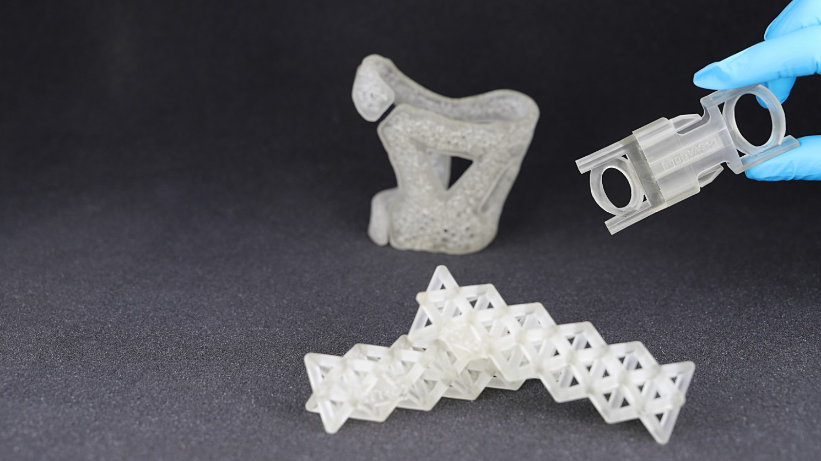
Our Mission
We enable our customers
to shape the
Additive Manufacturing industrial revolution.

Slide 11





Ultracur3D® ST 1400
Contact Details
Any questions left?
Let’s talk!
www.forward-am.com
sales@basf-3dps.com
+49 6221 67417-900
linkedin.com/company/basf-forwardam
At Forward AM we strive to provide you with the best service possible.
If you have questions about our materials, technologies or services, or would like to request an expert consultation, we will be delighted to hear from you!

