Slide 1
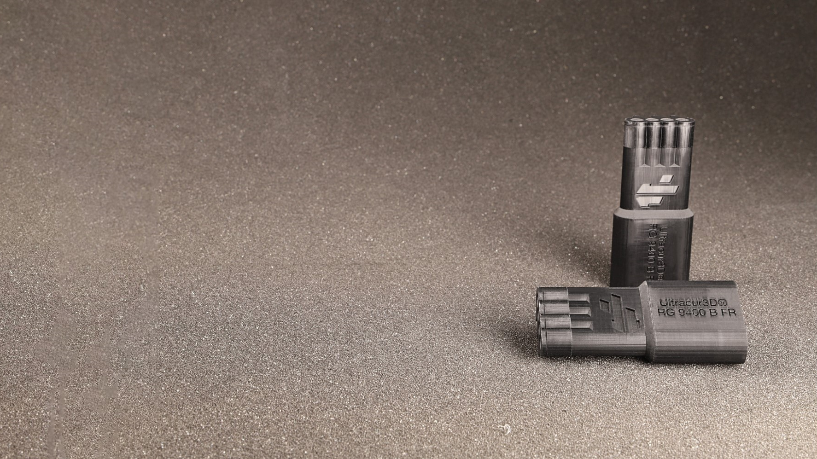
Ultracur3D® RG 9400 B FR
^{Product Launch Package}
BASF 3D Printing Solutions (B3DPS)
Status October 2023

Slide 2
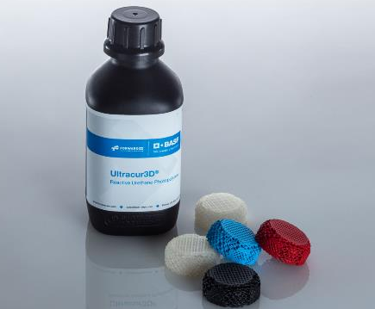
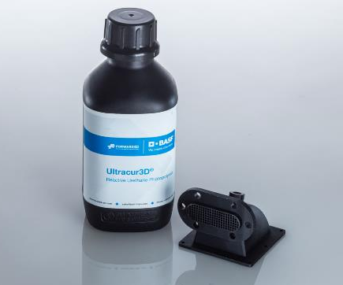
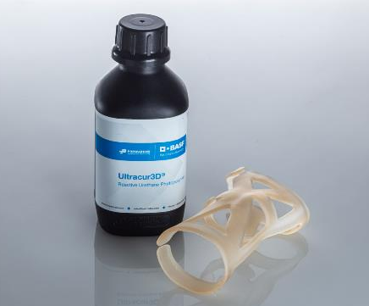
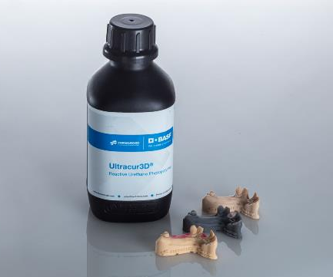
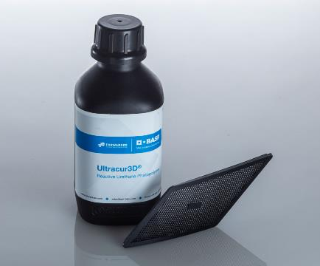
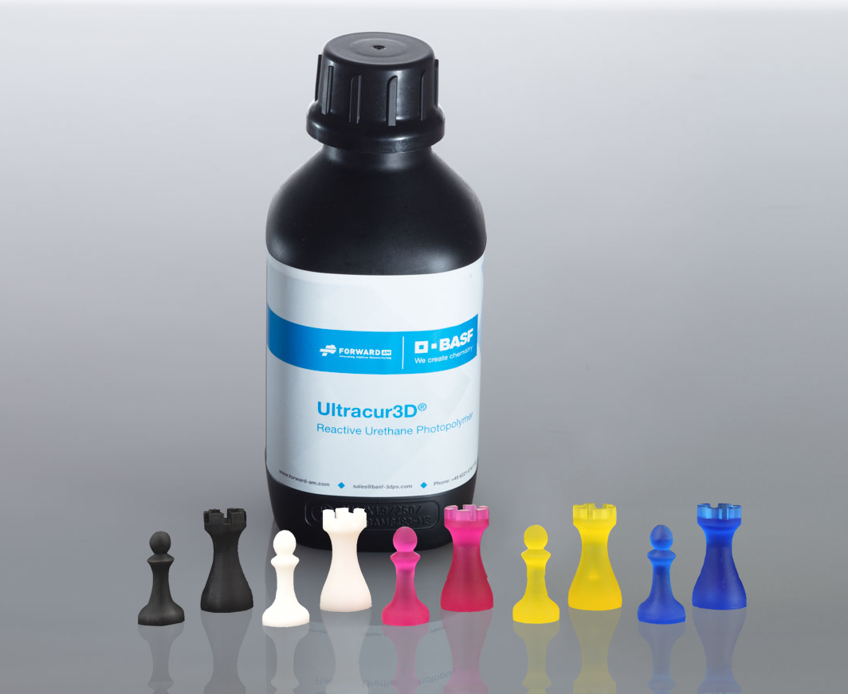
Ultracur3D® Photopolymer Solutions – Our product lines
Flexible
Tough
Rigid
Dental
Daylight
Supplementary

Slide 3
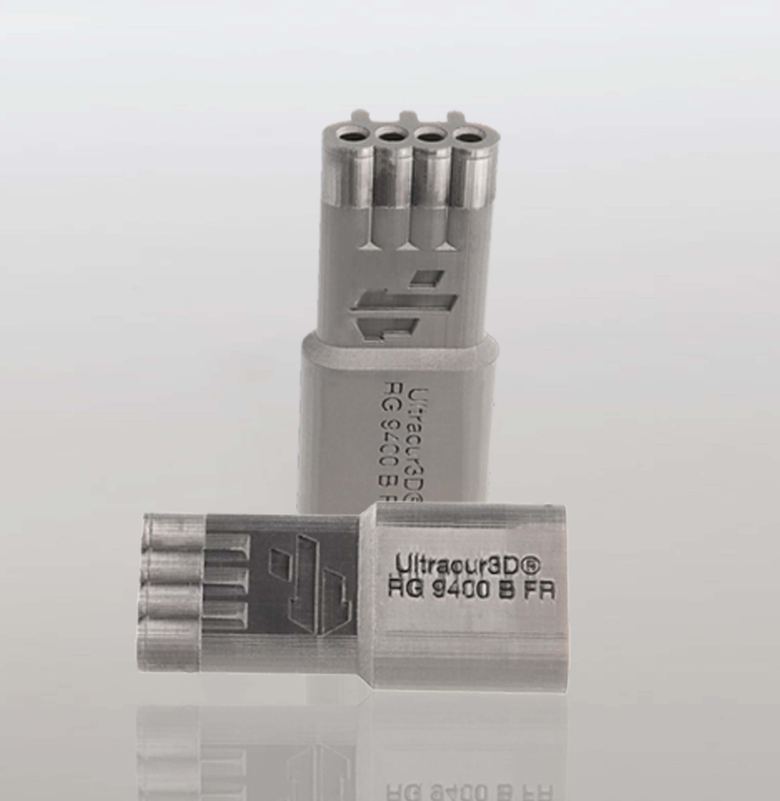
Ultracur3D® RG 9400 B FR
Material Introduction
Ultracur3D® RG 9400 B FR is a rigid, flame-retardant material that can be used for production parts requiring UL 94 V-0 rating. The material is halogen free, and in addition to its flame-retardant properties, it has a very high HDT, making it ideal for demanding applications in electronics, custom jigs & fixtures as well as replacement parts for industrial environments.
Ultracur3D® RG 9400 B FR distinguishes itself from other flame-retardant materials for having a low viscosity and being very easy to handle and print.
The material is available in black.

Slide 4
Ultracur3D® RG 9400 B FR
Value Proposition
Young’s modulus | 3900 MPa
Tensile strength | 78 MPa
Elongation at break | 3%
HDT (0.45 MPa) | 255°C
HDT (1.82 MPa) | 86°C
Flammability | UL 94 V-0 at 3mm
Viscosity, 30 °C | 350 mPas
Available color(s) | Black
Compatible technologies | DLP, LCD
Ultracur3D® RG 9400 B FR:
Flame-retardant resin with UL 94 V-0 rating and superior HDT
Flame-retardant (UL 94 V-0 at 3mm)
Very high temperature resistance (HDT B >250°C)
Easy to print and process, no heated printer required
Color: Black
General availability: November 2023

Slide 5
Ultracur3D® RG 9400 B FR
Benchmarking
 | RG 35 | RG 1100 | RG 3280 | RG 9400 B FR | Competitor product 1
Young’s modulus | 2600 MPa | 3080 MPa | 10600 MPa | 3900 MPa | 3556 MPa
Tensile strength | 80 MPa | 70 MPa | 87 MPa | 78 MPa | 66 MPa
Elongation at break | 6% | 5% | 1.3% | 3% | 2.1%
HDT (0.45 MPa) | 83°C | 116°C | 284°C | 255°C | >300°C
HDT (1.82 MPa) | 64°C | 84°C | 132°C | 86°C | 214°C
Flammability UL 94 | HB at 1.5mm | HB at 1.5mm | HB at 1.8mm | V-0 at 3mm | V-0 at 3mm
Viscosity, 30 °C | 600 mPas | 200 mPas | 230 mPas | 350 mPas | 830 mPas (65°C)
Water absorp-tion (24h) | 0.33% | 0.32% | 0.29% | 0.65% | 0.3%
Ultracur3D® RG 9400 B FR distinguishes itself from other flame-retardant materials for having a low viscosity and being very easy to handle and print.
Combined with a very high temperature resistance, it further strengthens our rigid resins portfolio and allows for more demanding high-temperature applications as for example in electronics and transportation.
Compared to existing products on the market, Ultracur3D® RG 9400 B FR shows overall a similar performance but with a significantly lower viscosity leading to easier handling and printing.
Additionally, this material is halogen and TPO free.

Slide 6





Ultracur3D® RG 9400 B FR
Certifications & Post-Processing
Flammability
  UL 94 V-0 rating passed at 3mm.
Bio compatibility
  Not tested.
Sterilization
  Not tested.
Chemical resistance
  Testing ongoing. Results available soon.
UV resistance
  Testing ongoing. Results available soon.

Slide 7
Ultracur3D® RG 9400 B FR
Example of Suitable 3D-Printers and Settings*
PRINTER | MIICRAFT ULTRA 125 | MIICRAFT ULTRA 125 Y | RAPIDSHAPE I30+ | STRATASYS ORIGIN ONE
Wavelength | 405 nm | 385 nm | 385 nm | 385 nm
Power | 4 mW/cm² | 4 mW/cm² | 2 mW/cm² | 5 mW/cm²
Curing time | 3.5 s | 2.5 s | 3 s | 3 s
Voxel depth | 100 μm | 100 μm | 100 μm | 100 μm
Evaluation on additional systems ongoing.
Further details can be found in the User Guideline.
* This is only a general indication for compatibility, as there is a very wide range of different printers available in the
market. If you have any question about machine compatibility, contact us at sales@basf-3dps.com

Slide 8
Ultracur3D® RG 9400 B FR
Available Documents
TDS
MSDS*
User Guideline
Certifications
Pictures
Not yet available.
Pictures_
Ultracur3D_ RG 9400 B FR
Extended TDS_Ultracur3D_RG 9400 B FR
UG_Ultracur3D_RG 9400 B FR
Video_
Ultracur3D_ RG 9400 B FR
NOTE: All MSDS are only initial and will not be updated in this presentation.
However, the links to the rest of the documents are always up-to-date. We recommend to use them instead of downloading the documents.
* MSDS available for the following countries:
US, CA, MX, EU, DE, AT, CH, BE, NL, LU, FR, ES, GB, IT, PL, CZ, DK, CN, TW, JP, KR, AU, NZ, MY, SG, BR

Slide 9
Ultracur3D® RG 9400 B FR
Battle card
Material overview
Key features
FAQ
Ultracur3D® RG 9400 B FR is a flame-retardant resin with UL 94 V-0 rating and superior HDT. The resin is characterized by:
Flame-retardancy with UL 94 V-0 rating at 3mm
Very high temperature resistance with HDT B > 250°C
Easy printing and processing (no heated printer required)
Novel flame-retardant resin with low viscosity ensuring easy handling and printing
Its unique properties guarantee temperature stability while being halogen and TPO free
The material is especially suitable for applications like electrical connectors, cable holders and housings requiring UL 94 V-0 rating
Is there a UL 94 blue card for this material?
We do perform our UL 94 tests in a UL-certified lab, but currently did not create an actual blue card yet. If there is a good business case, and an agreement on printer and process flow, we can certainly obtain a blue card for this material.
Does this material require a heated printer or thermal postcure?
This material requires preheating of the resin, but no heating during the printing itself is needed. Thermal postcure is optional depending on the customer’s requirements.
Does this material pass FST (fire, smoke, toxicity) requirements?
These tests are still ongoing on our side.
Does this material contain halogens or TPO?
No, the material contains no halogens or TPO.
Does this material pass UL 94 V-0 at different thicknesses?
These tests are still ongoing on our side.
Target industries
Its UL 94 V-0 rating, high stiffness and very high temperature resistance is making this material ideal for demanding applications in electronics, transportation and aerospace.
Suitable 3D printer examples
  MiiCraft - Ultra 125 & Ultra 125 Y
  RapidShape – i30+
  Stratasys – Origin One

Slide 10
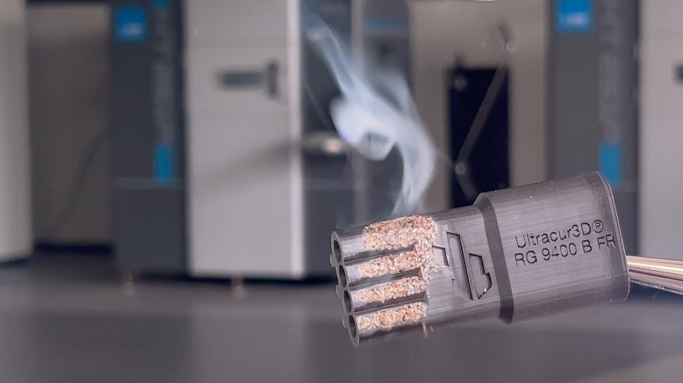
Our Mission
We enable our customers
to shape the Additive Manufacturing industrial revolution.

Slide 11





Ultracur3D® RG 9400 B FR
Contact Details
Any questions left?
Let’s talk!
www.forward-am.com
sales@basf-3dps.com
+49 6221 67417-900
linkedin.com/company/basf-forwardam
At Forward AM we strive to provide you with the best service possible.
If you have questions about our materials, technologies or services, or would like to request an expert consultation, we will be delighted to hear from you!

