Slide 1
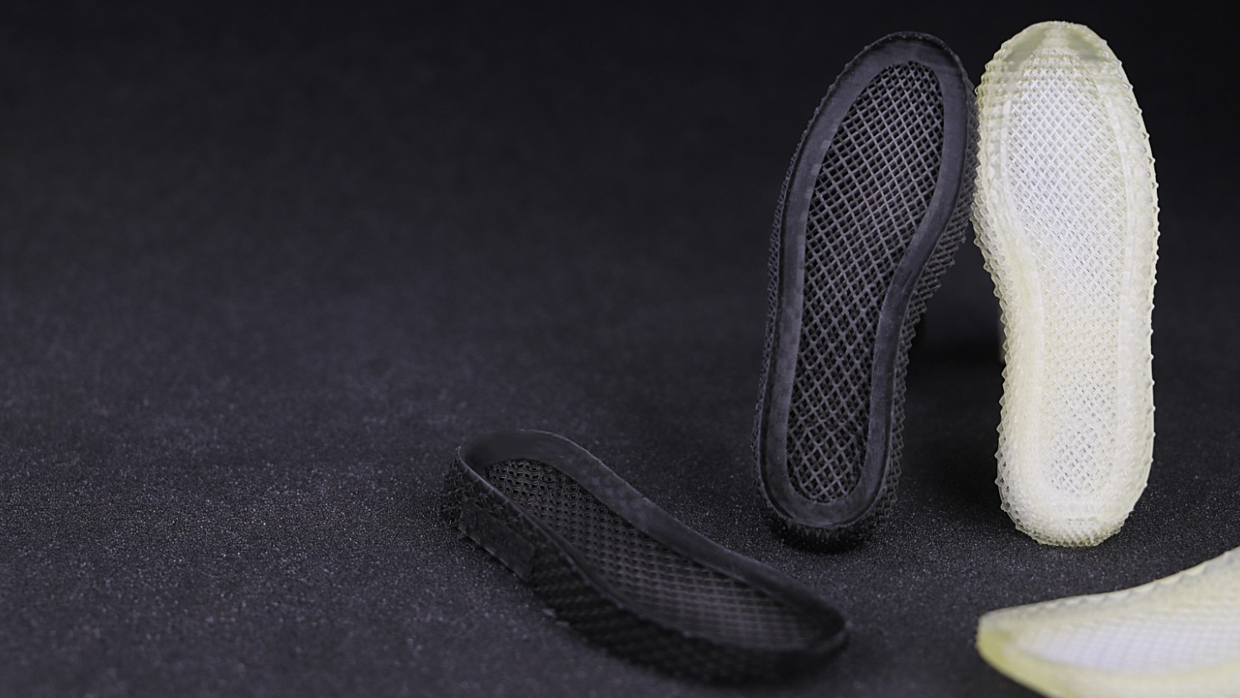
Ultracur3D® EL 4000 / 4000 B
^{Product Launch Package}
BASF 3D Printing Solutions (B3DPS)
Status November 2022

Slide 2
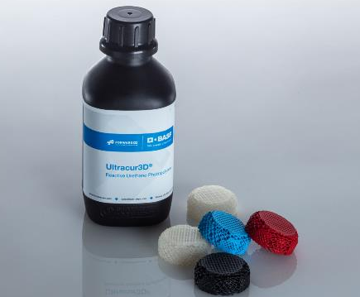
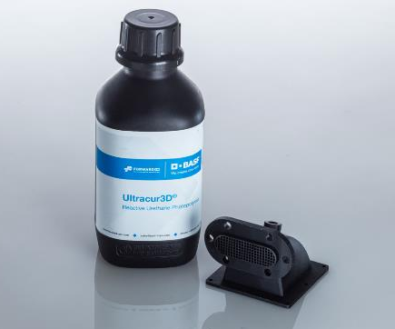
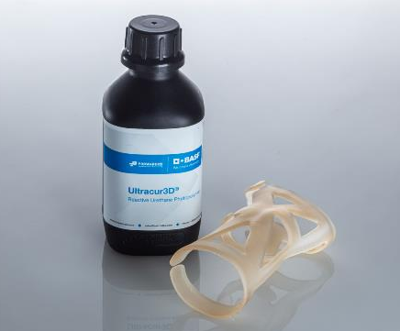
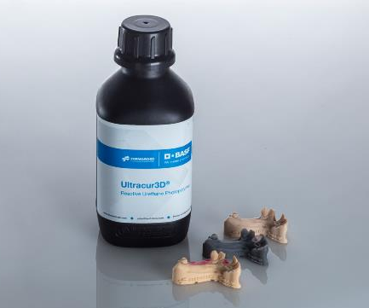
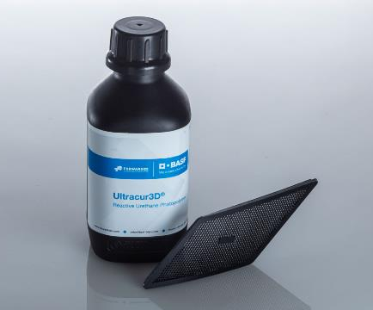
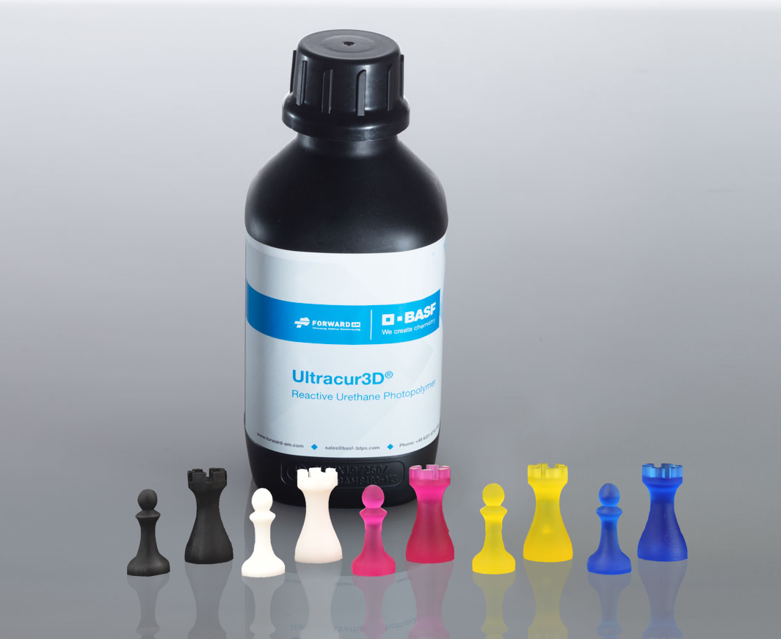
Ultracur3D® Photopolymer Solutions – Our product lines
Flexible
Tough
Rigid
Dental
Daylight
Supplementary

Slide 3
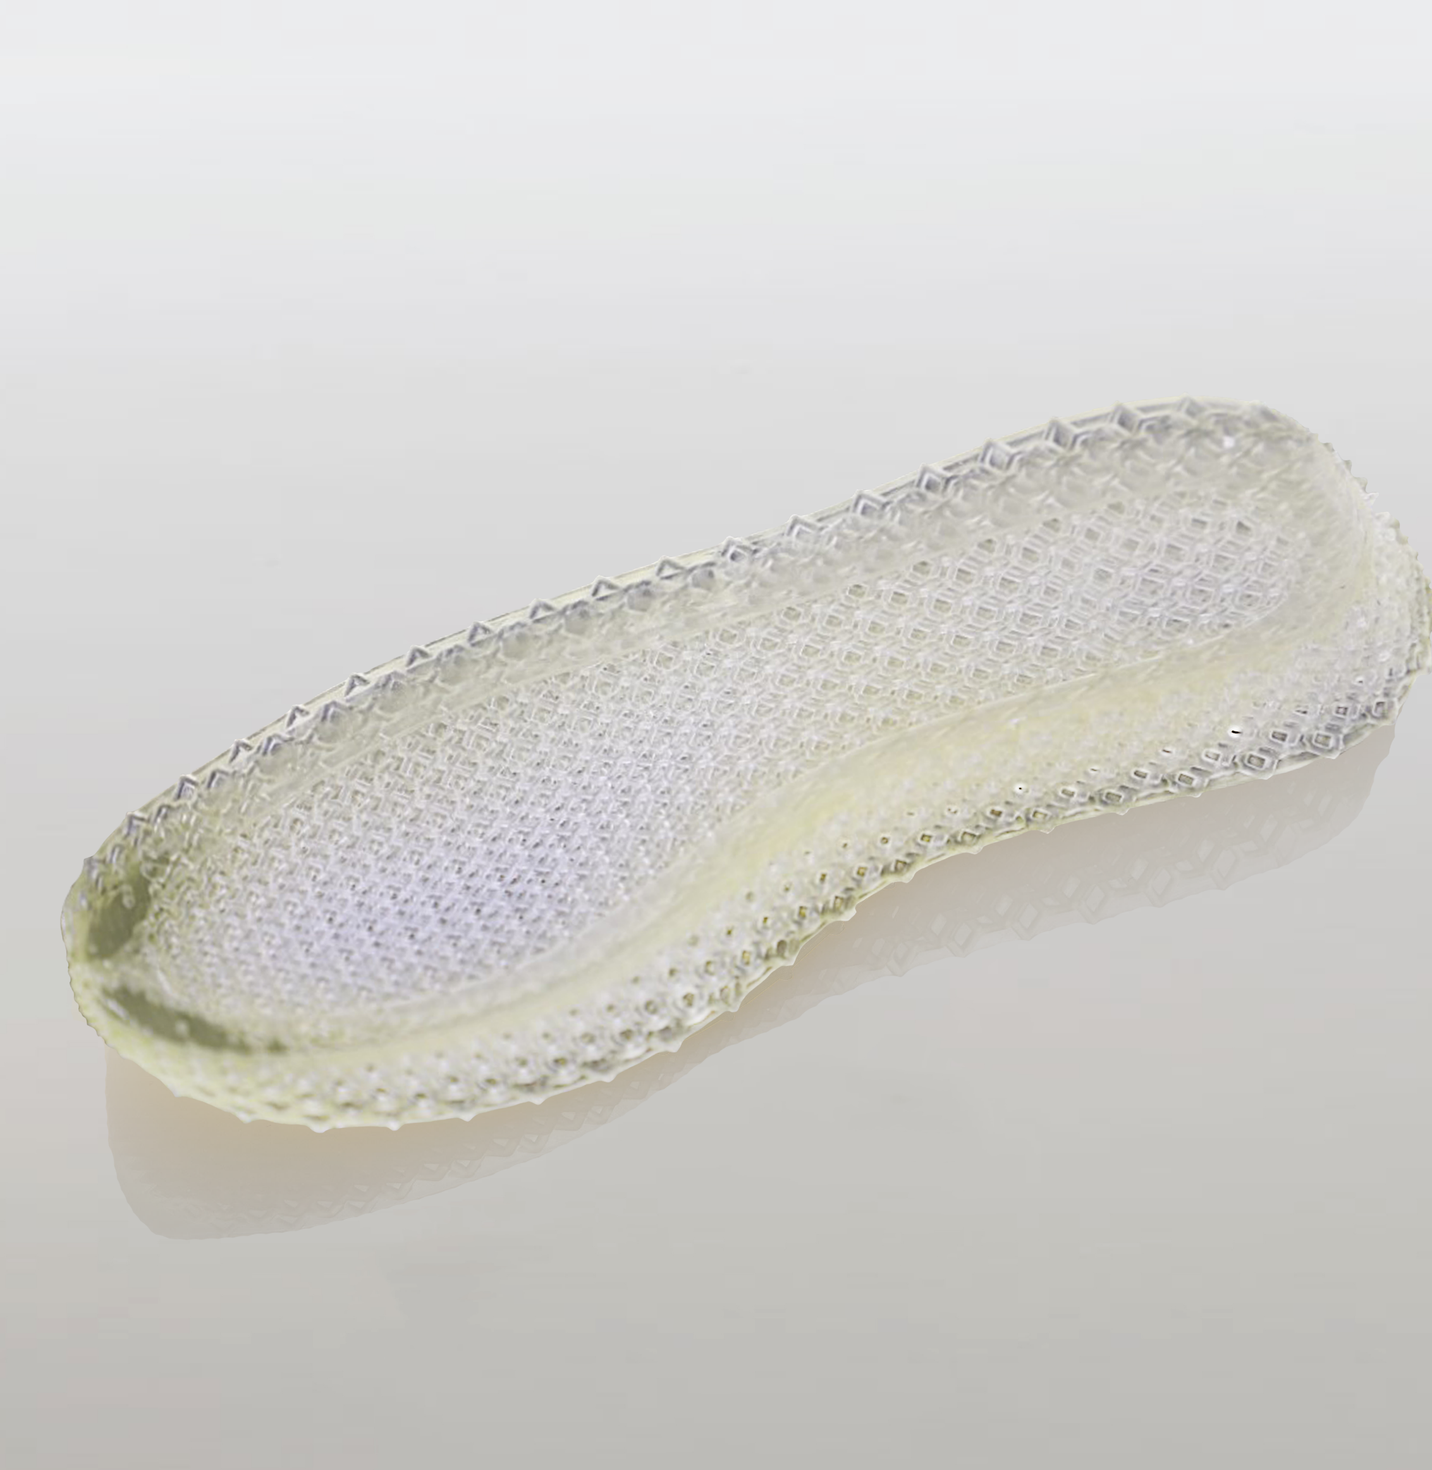
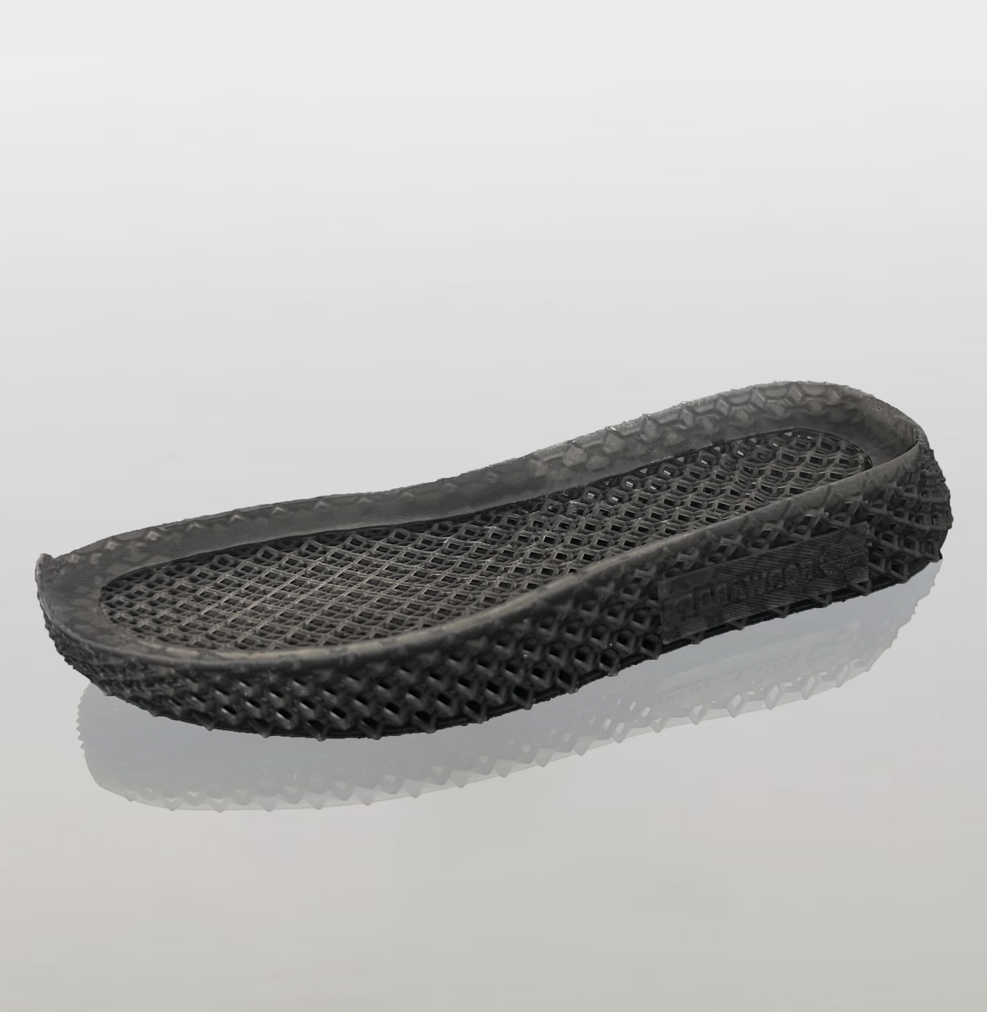
Ultracur3D® EL 4000 / 4000 B
Material Introduction
Ultracur3D® EL 4000 by Forward AM is the latest addition to our flexible and elastomeric resins. With its high hardness of shore 90 A, it is at the high end of our portfolio, which now covers the whole spectrum from Shore 40 A to 90 A.
Due to its superior strength, rebound and tear resistance, this material is perfectly suitable for applications such as footwear, bike saddles and cushioning pads.
The material is available in clear and black.

Slide 4
Ultracur3D® EL 4000 / 4000 B
Value Proposition
Ultracur3D® EL 4000 / 4000 B:
Flexible resin with superior strength,
rebound and high hardness (Shore 90 A)
High hardness (Shore 90 A)
High green strength, ideal for printing intricate flexible parts
Superior strength, rebound and tear resistance
Color: Clear and black
General availability:
02/2022 – Ultracur3D® EL 4000
07/2022 – Ultracur3D® EL 4000 B
 | EL 4000 | EL 4000 B
Young’s modulus | 42 MPa | 70 MPa
Tensile strength | 11 MPa | 11 MPa
Elongation at break | 172 % | 120 %
Hardness | 90 A | 84 A
Rebound resilience | 30 % | 26 %
Tear strength (Graves) | 37 N/mm | 49 N/mm
Available color(s) | Clear | Black
* This is only a general indication for compatibility, as there is a very wide range of different printers available in the
market. If you have any question about machine compatibility, contact us at sales@basf-3dps.com

Slide 5
Ultracur3D® EL 4000 / 4000 B
Benchmarking
With its high hardness of shore 90 A Ultracur3D® EL 4000 is at the high end of our portfolio of flexible and elastomeric resins, which now covers the whole spectrum from Shore 40 A to 90 A.
Combined with a high tensile and tear strength as well as a better performance in rebound resilience than Ultracur3D® EL 60 and EL 150 and comparable elongation at break to Ultracur3D® EL 150, it’s a novel material ready to withstand even tough environmental requirements.
Compared to an existing product on the market Ultracur3D® EL 4000 shows a better performance in tensile strength, elongation at break, rebound resilience and tear strength.
Additionally, its high tear strength as well as high hardness makes it a robust material ready to fulfill the strongest requirements of our customers.
 | EL 60 | EL 150 | EL 4000 | EL 4000 B | Competitor product
Young’s modulus | 50 MPa | 16 MPa | 42 MPa | 70 MPa | -
Tensile strength | 9 MPa | 7 MPa | 11 MPa | 11 MPa | 8.9 MPa
Elongation at break | 95 % | 182 % | 172 % | 120 % | 120 %
Hardness | 75 A | 75 A | 90 A | 84 A | 80 A
Rebound resilience | 21 % | 28 % | 30 % | 26 % | 28 %
Tear strength (Graves) | 18 N/mm | 14 N/mm | 37 N/mm | 49 N/mm | 24 N/mm

Slide 6







Ultracur3D® EL 4000 / 4000 B
Certifications & Post-Processing
Bio compatibility
  Not tested.
Sterilization
  Not tested.
Chemical resistance
  Tested on Ultracur3D® EL 4000. Results available for cooling fluid, multipurpose fat, engine oil, hydraulic oil, brake fluid, transmission oil, acetone and isopropanol.
UV resistance
  Tested on Ultracur3D® EL 4000. Testing results available as per the ISO Norm ISO 4892-2:2013 Method A.
Coating
  Testing planned.

Slide 7

Ultracur3D® EL 4000 / 4000 B
Example of Suitable 3D-Printers and Settings
Evaluation on additional systems ongoing.
Further details can be found in the User Guideline.
PRINTER | STRATASYS ORIGIN ONE | MIICRAFT ULTRA 125 | ATUM3D DLP STATION 5 | ATUM3D DLP STATION 5 EXZ
Wavelength | 385 nm | 385 nm | 405 nm | 405 nm
Power | 5 mW/cm² | 4 mW/cm² | 15 mW/cm² | 15 mW/cm²
Curing time | 1.1 s | 2.5 s | 1.2 s | 1.2 s* / 3 s**
Voxel depth | 50 μm | 100 μm | 100 μm | 100 μm* / 200 μm**
* Ultracur3D® EL 4000
** Ultracur3D® EL 4000 B

Slide 8
Ultracur3D® EL 4000 / 4000 B
Available Documents
TDS
MSDS*
User Guideline
Certifications
Pictures
Videos
Ultracur3D®
EL 4000
Pictures_
Ultracur3D_EL 4000
TDS_Ultracur3D_EL 4000
UG_Ultracur3D_EL 4000
Chemical test_Ultracur3D_EL 4000
Video_
Ultracur3D_EL 4000
Pictures_
Ultracur3D_EL 4000 & 4000 B
Ultracur3D®
EL 4000 B
TDS_Ultracur3D_EL 4000 B
UG_Ultracur3D_EL 4000 B
Video_
Ultracur3D_EL 4000 B
Not yet available
Pictures_
Ultracur3D_EL 4000 B
NOTE: All MSDS are only initial and will not be updated in this presentation.
However, the links to the rest of the documents are always up-to-date. We recommend to use them instead of downloading the documents.
* MSDS available for the following countries:
US, CA, MX, EU, DE, AT, CH, BE, NL, LU, FR, ES, GB, IT, PL, CZ, DK, CN, TW, JP, KR, AU, NZ, MY, SG, BR

Slide 9
Ultracur3D® EL 4000 / 4000 B
Battle card
Material overview
Key features
FAQ
Ultracur3D® EL 4000/4000 B is a flexible resin with superior strength, rebound and high hardness (Shore 90 A / 84 A). The material is characterized by:
High hardness (Shore 90 / 84 A)
High green strength, ideal for printing intricate flexible parts
Superior strength, rebound and tear resistance
Novel elastomeric material fulfilling even the strongest requirements of our customers
Combination of high tensile and tear strength with a good performance in rebound resilience and elongation at break
Is this material chemical resistant?
We have performed chemical resistance tests on the Ultracur3D® EL 4000 material. The compatibility with cooling fluid, multi-purpose fat, engine oil, hydraulic oil, brake fluid, transmission oil, acetone and isopropanol was tested and indications on material changes were studied. Detailed results can be found HERE.
Is this material biocompatible?
Biocompatibility tests are ongoing. Testing results will be shared soon.
Is this material UV resistant?
UV resistance tests are ongoing. Testing results will be shared soon.
Example of suitable 3D printer
Target industries
Ultracur3D® EL 4000
  Stratasys – Origin One
Ultracur3D® EL 4000 & 4000 B
  MiiCraft – Ultra 125
  atum3D - DLP STATION 5 & DLP STATION 5 EXZ
Thanks to its superior strength, rebound and tear resistance, this material is perfectly suitable for applications such as footwear, bike saddles and cushioning pads.

Slide 10
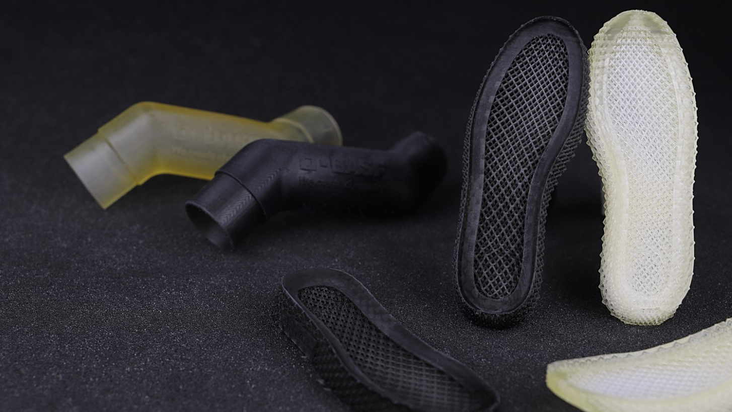
Our Mission
We enable our customers
to shape the Additive Manufacturing industrial revolution.

Slide 11





Ultracur3D® EL 4000 / 4000 B
Contact Details
Any questions left?
Let’s talk!
www.forward-am.com
sales@basf-3dps.com
+49 6221 67417-900
linkedin.com/company/basf-forwardam
At Forward AM we strive to provide you with the best service possible.
If you have questions about our materials, technologies or services, or would like to request an expert consultation, we will be delighted to hear from you!

