Slide 1
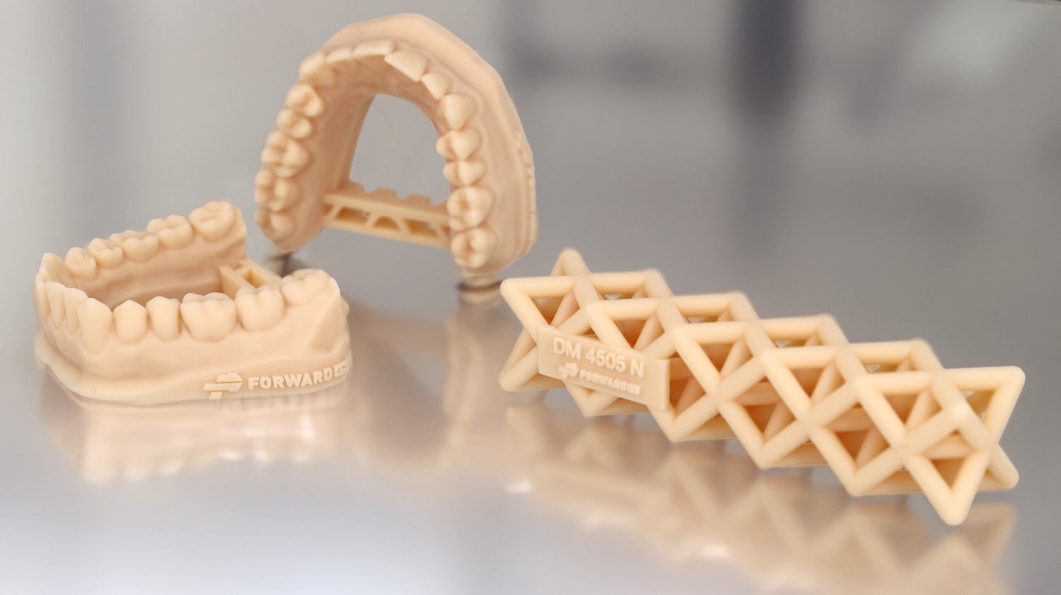
Ultracur3D® DM 4505 N
^{Dental | Model | Natural}
^{Product Launch Package}
Forward AM Technologies
Status August 2024

Slide 2
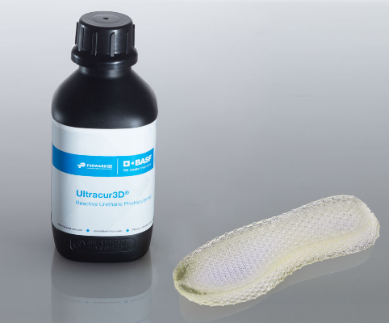
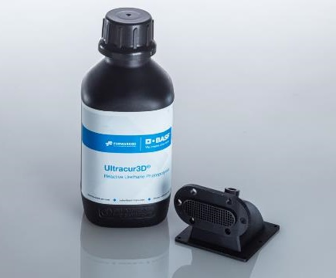
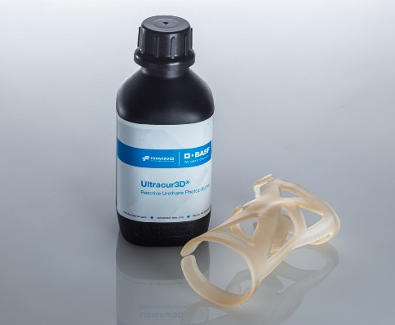
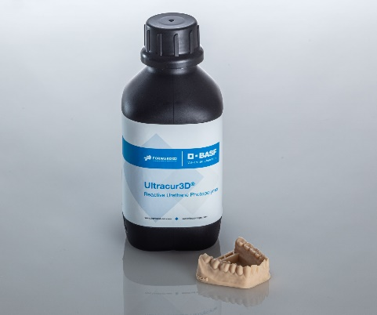
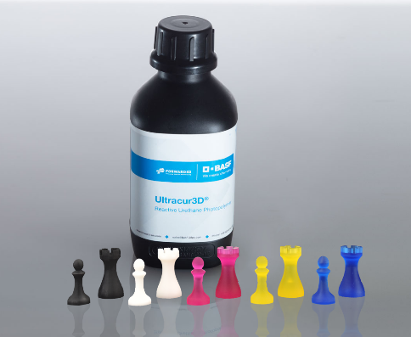
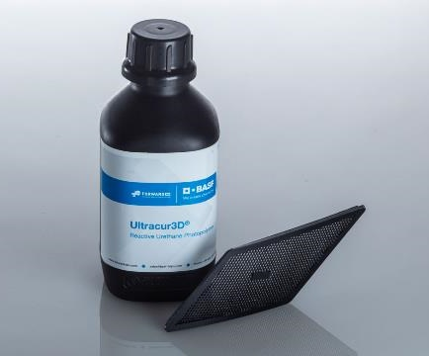
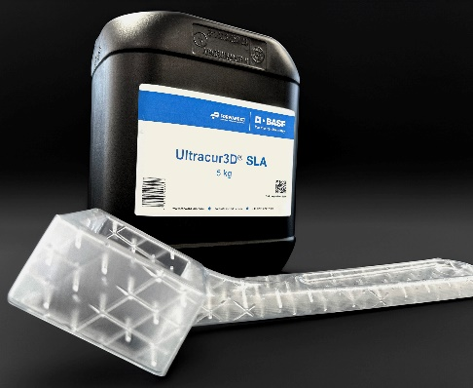
Ultracur3D® Photopolymer Solutions – Our product lines
  Ultracur3D®
  Product Portfolio
Flexible
Tough
Rigid
Dental
Supplementary
  Technology Specific
Daylight
SLA

Slide 3
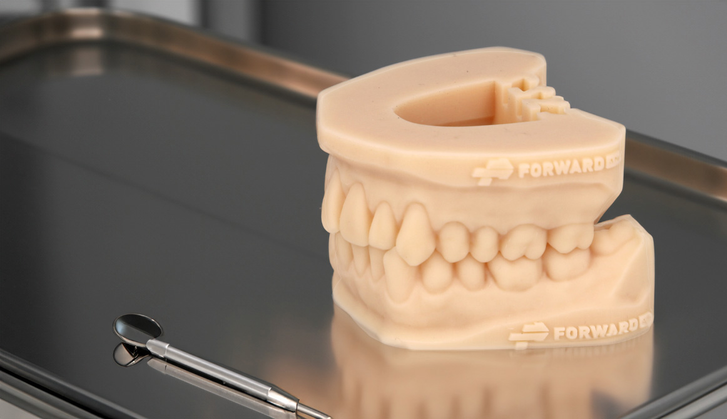
Ultracur3D® DM 4505 N
Material Introduction
Ultracur3D® DM 4505 N is a material specifically designed for dental applications. Due to its exceptional dimensional accuracy and surface finish, this resin offers a reliable solution for producing dental models and aligner thermoforming molds. Its water-washable formulation makes it easy and safe to handle without the use of chemical cleaners.
Ultracur3D® DM 4505 N is available in natural beige color.

Slide 4
Ultracur3D® DM 4505 N
Value Proposition
Ultracur3D® DM 4505 N:
Water-washable dental resin for highly accurate models and molds
Highly accurate and consistent models and molds
Great surface quality, showing crisp details
Parts can be washed with water, for easy and safe handling
Color: Natural beige
General availability: September 2024
Young’s modulus | 2500 MPa
Tensile strength | 55 MPa
Elongation at break | 5%
HDT (0.45 MPa) | 79°C
HDT (1.82 MPa) | 58°C
Viscosity, 30 °C | 800 mPas
Available color(s) | natural beige
Compatible technologies | DLP, LCD

Slide 5
Ultracur3D® DM 4505 N
Benchmarking
 | DM 2505 | DM 4505 N | Competitor product 1
Young’s modulus | 2200 MPa | 2500 MPa | 2450 MPa
Tensile strength | 48 Mpa | 55 MPa | 57 MPa
Elongation at break | 4% | 5% | 5.4%
Viscosity, 25 °C | 100 mPas | 1200 mPas | 1380 mPas
Cleaning | Water-washable | Water-washable | Not water-washable
Color | Light beige | Natural beige | Dark beige
Printing speed | Medium | Medium | Medium
Pigment stability | Low | High | High
Regulatory / EHS |  | TPO free TMPTA free
Ultracur3D® DM 4505 N is the latest addition to our dental portfolio. Due to the high pigment stability of the material, there is no need for frequent mixing. Compared to Ultracur3D® DM 2505, this material is more matte, with an improved accuracy stability over time.
Compared to existing products on the market, Ultracur3D® DM 4505 N is water-washable making it easy and safe to handle without the use of chemical cleaners.
Additionally, this material is TPO and TMPTA free.

Slide 6



Ultracur3D® DM 4505 N
Certifications & Post-Processing
Accuracy
  Accuracy scan tests done. Results available in the extended TDS.
Long term stability
  Long term scan tests done. Results available in the extended TDS.
Pressure & temperature resistance
  Results available in the extended TDS.

Slide 7
Ultracur3D® DM 4505 N
Example of Suitable 3D-Printers and Settings*
PRINTER | ASIGA MAX UV | MIICRAFT ULTRA 125 | MIICRAFT ULTRA 125 Y | RAPIDSHAPE I30+
Wavelength | 385 nm | 405 nm | 385 nm | 385 nm
Power | 7 mW/cm² | 4 mW/cm² | 4 mW/cm² | 2 mW/cm²
Curing time | 2.1 s | 3 s | 3.5 s | 3.5 s
Voxel depth | 100 μm | 100 μm | 100 μm | 100 μm
Evaluation on additional systems ongoing.
Further details can be found in the User Guideline.
* This is only a general indication for compatibility, as there is a very wide range of different printers available in the
market. If you have any question about machine compatibility, contact us at sales@forward-am.com

Slide 8
Ultracur3D® DM 4505 N
Available Documents
TDS
MSDS*
User Guideline
Certifications
Pictures
Not yet available.
Pictures_
Ultracur3D_ DM 4505 N
Extended TDS_Ultracur3D_DM 4505 N
UG_Ultracur3D_DM 4505 N
NOTE: All MSDS are only initial and will not be updated in this presentation.
However, the links to the rest of the documents are always up-to-date. We recommend to use them instead of downloading the documents.
* MSDS available for the following countries:
US, CA, MX, EU, DE, AT, CH, BE, NL, LU, FR, ES, GB, IT, PL, CZ, DK, CN, TW, JP, KR, AU, NZ, MY, SG, BR

Slide 9
Ultracur3D® DM 4505 N
Battle card
Material overview
Key features
FAQ
The resin is characterized by:
Highly accurate and consistent models and molds
Great surface quality, showing crisp details
Parts can be washed with water, for easy and safe handling
Highly accurate and consistent models and molds with great surface quality
Due to high pigment stability, there is no need for frequent mixing
Green parts are not brittle and therefore easy to remove from platform
This material is TPO and TMPTA free
Do you have this material in other colors?
We are working on a grey version. Other colors are possible upon customer request, if there is significant volume behind.
Can I use this material for removable dies?
Partners have tested this application successfully on their printer with their settings, so in principle yes, it might work but may require further optimization on printing and design, depends on the software and 3D printer.
Can I treat the water used for cleaning as regular waste water?
Even though water is used for the cleaning, this water will contain photopolymer traces after use and should be handled according to local regulations for chemical waste.
Target industries
Ultracur3D® DM 4505 N is a material specifically designed for dental applications. The material is especially suitable for applications like dental models and aligner thermoforming molds.
Suitable 3D printer examples
  Asiga – Max UV
  MiiCraft - Ultra 125 & Ultra 125 Y
  RapidShape – i30+
  More coming soon

Slide 10
Our Mission
We enable our customers
to shape the Additive Manufacturing industrial revolution.

Slide 11





Ultracur3D® DM 4505 N
Contact Details
Any questions left?
Let’s talk!
www.forward-am.com
sales@forward-am.com
+49 6221 67417-900
linkedin.com/company/basf-forwardam
At Forward AM we strive to provide you with the best service possible.
If you have questions about our materials, technologies or services, or would like to request an expert consultation, we will be delighted to hear from you!

